Slide 1
Query Store and SSMS Copilot
Who Is the Fairest in the Land?
From Query Store evidence to guided and autonomous troubleshooting with SSMS Copilot, Agent Mode and Agent Skills

Slide 4

whoami
Marzio Da Ros
support Engineer @Microsoft
Supporting SQL Server Core
4 Years @ Microsoft
Worked previously as DBA in other companies for more than 25 years, managing SQL Server since SQL Server 2000 version.

Slide 5
What you will learn
Three outcomes for today’s session
1
1 · Read the evidence
2
2 · Diagnose the change
3
3 · Automate the method
Use Query Store to identify the dominant performance resource, the main contributing query, and how its behavior changes over time.
Correlate plans, CPU, duration, logical reads, selectivity, statistics, and indexes to build a root-cause hypothesis from evidence.
Use GitHub Copilot Agent Mode and reusable Agent Skills to standardize SQL performance troubleshooting across SQL Server and Azure SQL.
Goal: move from “this query is slow” to a repeatable, evidence-driven troubleshooting workflow.

Slide 6
Agenda
One troubleshooting story — three Copilot experiences
ASK MODE
AGENT MODE
AGENT SKILL
Guided investigation
Autonomous investigation
Reusable methodology
You ask, Copilot interprets the current evidence.
Copilot executes approved read-only diagnostics and iterates.
Encode the runbook once and reuse it from SSMS / GitHub Copilot.
Troubleshooting storyline
1
2
3
4
5
6
7
8
Symptom
Dominant metric
Top query
Plans & timeline
Same-plan degradation
Selectivity / stats / indexes
Remediation
Validation

Slide 7
The starting point
“SQL is slow.” That is a symptom — not a diagnosis.
The first question is not “which plan is bad?”
The first question is: what resource is driving the impact?
CPU
How much processor time?
Duration
How long does it take?
Logical reads
How much data is touched?
Executions
How often does it happen?
Waits
Where does the query spend time?
Query Store gives us the historical evidence to answer these questions.

Slide 8
Query Store = the evidence layer
History lets us compare what changed, not just what is happening now
Runtime history
Query
Query text · Query ID · object name
Plans
Plan IDs · first/last seen · plan history
Runtime
20:45
20:50
20:55
21:00
21:05
CPU · duration · logical reads · executions · waits
same query • same plan can still behave very differently

Slide 9
Our demo lab
Powershell workload
dbo.GiveNotes
dbo.Notes
Query Store + Copilot
Random @N values
Repeated executions
WHERE ID BETWEEN @N …
GROUP BY Name
Rows grow
Distribution changes
Observe · compare · explain · validate
We intentionally avoid giving Copilot the answer: it must discover the query, Query ID, all Plan IDs, the timeline, and the most likely explanation from evidence.

Slide 10
Live demo
Simulating the issue

Slide 11
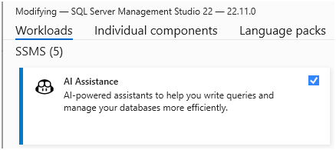
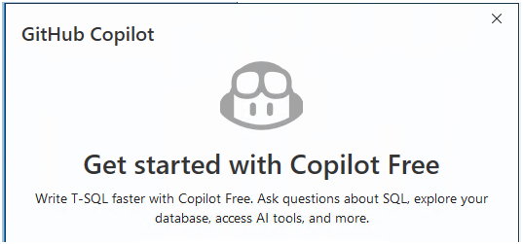
Preparing the environment (1)
Prerequisites:
- SSMS 22.7 or later
- The AI Assistance workload installed
- GitHub Copilot access in SSMS
- GitHub Copilot Chat running in Agent mode

Slide 12
Mode 1 — Ask
A guided conversation with Query Store evidence
1
What resource dominates?
What we can learn
Which query contributes most?
Ask mode is excellent for interpreting the current grid and walking through evidence step by step.
2
How does it behave over time?
But in our session it could not execute arbitrary new ad-hoc Query Store T-SQL from chat.
3
4
What changed while the same plan was reused?
That is where Agent Mode changes the experience.

Slide 13
Live demo
Ask SSMS
1. Find the problem
2. Watch the Agent investigate
3. Re-run with the reusable skill

Slide 14
Mode 2 — Agent
Give Copilot the goal, not the individual steps
High-level goal
“Investigate the SQL performance problem.”
Agent Mode in SSMS
Plan the investigation
Choose the next read-only diagnostic.
sql-tools
read-only diagnostics
approval loop
Agent Mode can execute queries, inspect the result, and decide the next diagnostic step — while the SQL execution still runs under the permissions of the active database context.
Execute with approval
Use SSMS sql-tools and the current connection.
Read the result
Update the working hypothesis from evidence.
This is the workflow we wanted from the beginning.
Iterate
Continue until diagnosis or user input is needed.

Slide 15
Live demo
Agent SSMS
1. Find the problem
2. Watch the Agent investigate
3. Re-run with the reusable skill

Slide 16
Mode 3 — Agent Skill
Turn a good troubleshooting conversation into a reusable operating procedure
One skill, many entry points
.github/
└── skills/
└── sql-performance-investigator/
├── SKILL.md
└── references/
├── workflow.md
└── query-store-rules.md
SSMS Agent
GitHub Copilot CLI
Query Store + sql-tools
Skill + MCP / SQL tool
Visual Studio / IDE
Team standard
Same method, new surface
Evidence → diagnosis → validation
Guardrails: read-only discovery first • no hard-coded Query IDs / Plan IDs • separate evidence from hypothesis • propose remediation, do not silently apply it

Slide 17
Run the investigation in SSMS Agent Mode
One high-level goal; SSMS Agent Mode executes approved read-only diagnostics and keeps the investigation state
1
Open Copilot Chat
4
Enable the skill
View → GitHub Copilot Chat
Skills → sql-performance-investigator
Use the sql-performance-investigator skill.
Investigate the SQL performance problem in the current database using Query Store.
Automatically discover the dominant metric, target query, Query ID, all Plan IDs, runtime history, and any same-plan degradation.
Read-only diagnostics only. Do not apply remediation.
2
Switch to Agent
5
Start the investigation
Choose Agent instead of Ask
Connect to the target database and paste the high-level prompt
3
Enable SQL tools
6
Approve diagnostics
Tools → verify sql-tools is enabled
Let the Agent query, read the result, and choose the next diagnostic
Key behavior: no manually typed Query IDs or Plan IDs.

Slide 18
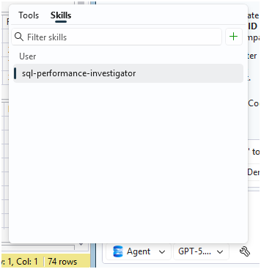
Preparing the environment (2)
Skills:
Location of Copilot skills files used in this demo:
“%USERPROFILE%\.copilot\skills\sql-performance-investigator\”
Useful link related to skills:
  https://learn.microsoft.com/en-us/ssms/github-copilot/agent-skills
- Skill related files used in this demo:
FullName Size
-------- ------
C:\Users\testuser\.copilot\skills\sql-performance-investigator\SKILL.md 6872
C:\Users\testuser\.copilot\skills\sql-performance-investigator\references\query-store-rules.md 2874
C:\Users\testuser\.copilot\skills\sql-performance-investigator\references\workflow.md 5400

Slide 19
Live demo
Skill SSMS
1. Find the problem
2. Watch the Agent investigate
3. Re-run with the reusable skill

Slide 20
The key diagnostic moment
Same Plan ID. Radically different runtime cost.
Example captured during the demo workload
Metric
Healthy interval
Degraded interval
Change
Avg CPU / exec
7.69 ms
1,443.19 ms
~188×
Avg duration / exec
12.39 ms
2,473.68 ms
~200×
Avg logical reads
68.39
12,233.10
~179×
If the same plan is still being reused, a plan change alone cannot explain when the degradation started. Something changed in the amount of work performed per execution.

Slide 21
From evidence to root cause
Same plan
More reads
Selectivity
Data distribution
Statistics
Indexes
Plan identity did not change
Much more work per execution
Predicate can touch very different row counts
How values are actually distributed
What the optimizer believes
Which access paths actually exist
The strongest hypothesis becomes a validation target — not a conclusion.
Confirmed evidence → inference → hypothesis → read-only validation → remediation

Slide 22
A concrete remediation candidate
Only after the evidence supports the access-path problem
Why ID is the key
CREATE NONCLUSTERED INDEX NOTES_IX1
ON dbo.Notes (ID)
INCLUDE (Name);
The predicate is ID < @N. The leading key supports a range access path.
Why INCLUDE(Name)
Name is required for the aggregation/output, but it does not need to widen the key.
Candidate, not victory: the change still has to earn its place with before/after Query Store evidence.
Statistics caveat
An index creates statistics on its key. INCLUDE columns do not automatically receive a histogram; do not drop auto stats without proving redundancy.

Slide 23
Live demo
Remediation
Remediation and validation

Slide 24
The demo storyline — from symptom to a proven fix
What happens during the investigation, and what each piece of evidence tells us
1
Symptom
2
Dominant resource
3
Main query
“SQL is slow.”
Start with impact, not a favorite hypothesis.
Query Store ranks CPU, duration, logical reads and execution volume.
Discover dbo.GiveNotes and its Query ID dynamically — never hard-code it.
4
Plans + timeline
5
Critical clue
6
Explain extra work
Collect every Plan ID and runtime interval. Reference run: 4 plans; IDs vary every run.
Same plan: CPU 7.69 → 1,443.19 ms; duration 12.39 → 2,473.68 ms; reads 68.39 → 12,233.10.
WHERE ID < @N changes selectivity. The same plan can process radically different row counts.
7
Validate metadata
8
Candidate fix
9
Prove it
Inspect distribution, statistics and access paths. Clustered PK is on id2, not ID.
CREATE INDEX Notes(ID) INCLUDE(Name) — then re-run an equivalent workload.
Use Query Store before/after: lower reads, CPU, duration and variability; no hidden regression.

Slide 25
Three takeaways
What to remember after the session
1
Query Store tells the story
2
Evidence before explanation
3
Agents make the method reusable
The useful question is not only “which query is expensive?” but “how did the query and its plans behave over time?”
Same-plan degradation is a powerful clue. Separate confirmed evidence from inference before naming a root cause.
Agent Mode can run the investigation. Agent Skills turn the support methodology into a repeatable team asset.
Query Store + SSMS Copilot = faster investigation without giving up engineering discipline.

Slide 26
Q&A
Questions, scenarios, and “what would you investigate next?”

Slide 27

Marzio Da Ros
Support Engineer SQL Server @Microsoft
/marzio-da-ros-58718bb
marziodaros@microsoft.com

